Slide 1
Beyond Classical Search Algorithms
Artificial Intelligence: A Modern Approach, 3rd Edition
Stuart Russell and Peter Norvig

Slide 2
Informed Search Algorithms…
Best-First Search…
A* Search…
Heuristics…

Slide 3
Best-First Search…
A Strategy Is Deﬁned By Picking The Order Of Node Expansion…
Use An Evaluation Function For Each Node – Estimate Of “Desirability”…
Expand Most Desirable Unexpanded Node…
Implementation: Fringe Is A Queue Sorted In Decreasing Order Of Desirability…
Special Cases: Greedy Search and A∗ Search

Slide 4
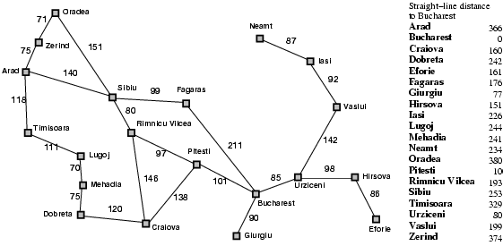
Romania With Step Costs In km…

Slide 5
Greedy best-first search
Evaluation Function h(n) = H(n)
(Heuristic) = Estimate Of Cost From N To Goal
E.G., H_{sld}(n) = Straight-line Distance From N To Bucharest Greedy Best-first Search Expands The Node That Appears To Be Closest To Goal

Slide 6

Greedy best-first search example

Slide 7
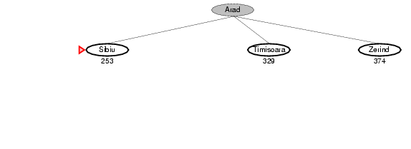
Greedy best-first search example

Slide 8
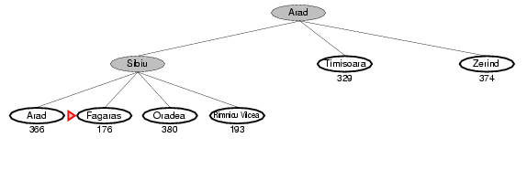
Greedy best-first search example

Slide 9
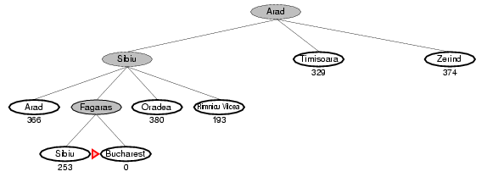
Greedy best-first search example

Slide 10
Properties of greedy best-first search
Complete? No – can get stuck in loops, e.g., Iasi → Neamt → Iasi → Neamt →
Time? O(b^{m}), but a good heuristic can give dramatic improvement
Space? O(b^{m}) -- keeps all nodes in memory
Optimal? No

Slide 11
A* search
Idea: avoid expanding paths that are already expensive
Evaluation function f(n) = g(n) + h(n)
g(n) = cost so far to reach n
h(n) = estimated cost from n to goal
f(n) = estimated total cost of path through n to goal

Slide 12

A* search example

Slide 13
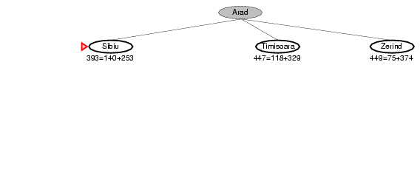
A* search example

Slide 14
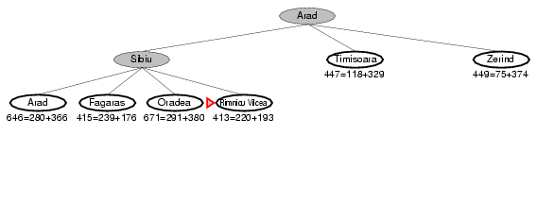
A* search example

Slide 15
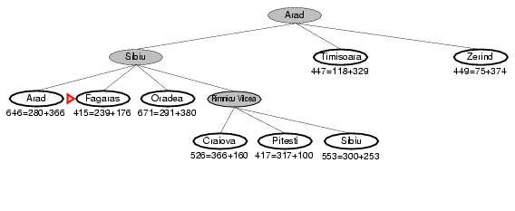
A* search example

Slide 16
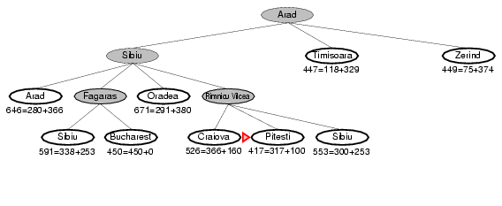
A* search example

Slide 17
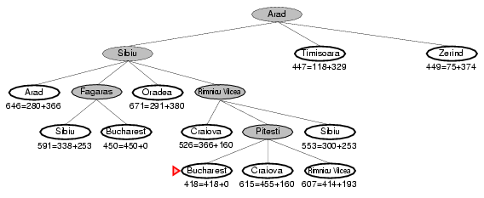
A* search example

Slide 18
Admissible heuristics
A heuristic h(n) is admissible if for every node n,
h(n) ≤ h*(n), where h*(n) is the true cost to reach the goal state from n.
An admissible heuristic never overestimates the cost to reach the goal, i.e., it is optimistic
Example: h_{SLD}(n) (never overestimates the actual road distance)
Theorem: If h(n) is admissible, A* using TREE-SEARCH is optimal

Slide 19
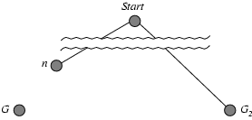
Optimality of A* (proof)
Suppose some suboptimal goal G₂ has been generated and is in the fringe. Let n be an unexpanded node in the fringe such that n is on a shortest path to an optimal goal G.
f(G₂) = g(G₂) since h(G₂) = 0
g(G₂) > g(G) since G₂ is suboptimal
f(G) = g(G) since h(G) = 0
f(G₂) > f(G) from above

Slide 20
Optimality of A* (proof)
Suppose some suboptimal goal G₂ has been generated and is in the fringe. Let n be an unexpanded node in the fringe such that n is on a shortest path to an optimal goal G.
f(G₂) > f(G) from above
h(n) ≤ h^*(n) since h is admissible
g(n) + h(n) ≤ g(n) + h*(n)
f(n) ≤ f(G)
Hence f(G₂) > f(n), and A* will never select G₂ for expansion

Slide 21
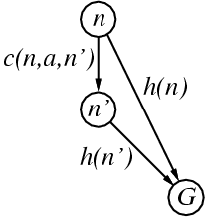
Consistent heuristics
A heuristic is consistent if for every node n, every successor n' of n generated by any action a,
h(n) ≤ c(n,a,n') + h(n')
If h is consistent, we have
f(n') = g(n') + h(n')
= g(n) + c(n,a,n') + h(n')
≥ g(n) + h(n)
= f(n)
i.e., f(n) is non-decreasing along any path.
Theorem: If h(n) is consistent, A* using GRAPH-SEARCH is optimal

Slide 22
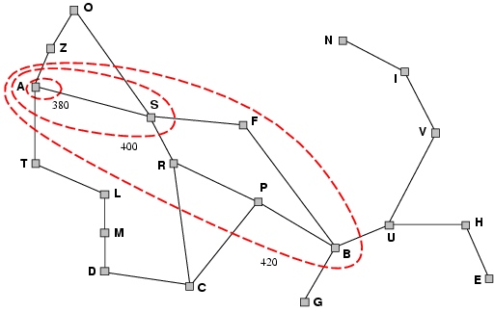
Optimality of A*
A* expands nodes in order of increasing f value
Gradually adds "f-contours" of nodes
Contour i has all nodes with f=f_{i}, where f_{i} < f_{i+1}

Slide 23
Properties of A$^*$
Complete? Yes (unless there are infinitely many nodes with f ≤ f(G) )
Time? Exponential
Space? Keeps all nodes in memory
Optimal? Yes

Slide 24
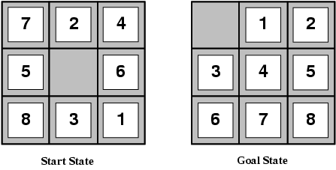
Admissible heuristics
E.g., for the 8-puzzle:
h₁(n) = number of misplaced tiles
h₂(n) = total Manhattan distance
(i.e., no. of squares from desired location of each tile)
h₁(S) = ?
h₂(S) = ?

Slide 25
Admissible heuristics
E.g., for the 8-puzzle:
h₁(n) = number of misplaced tiles
h₂(n) = total Manhattan distance
(i.e., no. of squares from desired location of each tile)
h₁(S) = ? 8
h₂(S) = ? 3+1+2+2+2+3+3+2 = 18

Slide 26
Dominance
If h₂(n) ≥ h₁(n) for all n (both admissible)
then h₂ dominates h₁
h₂ is better for search
Typical search costs (average number of nodes expanded):
d=12 IDS = 3,644,035 nodes A*(h₁) = 227 nodes A*(h₂) = 73 nodes
d=24 IDS = too many nodes A*(h₁) = 39,135 nodes A*(h₂) = 1,641 nodes

Slide 27
Relaxed problems
A problem with fewer restrictions on the actions is called a relaxed problem
The cost of an optimal solution to a relaxed problem is an admissible heuristic for the original problem
If the rules of the 8-puzzle are relaxed so that a tile can move anywhere, then h₁(n) gives the shortest solution
If the rules are relaxed so that a tile can move to any adjacent square, then h₂(n) gives the shortest solution

Slide 28
Local search algorithms
In many optimization problems, the path to the goal is irrelevant; the goal state itself is the solution
State space = set of "complete" configurations
Find configuration satisfying constraints, e.g., n-queens
In such cases, we can use local search algorithms
keep a single "current" state, try to improve it

Slide 29

Example: n-queens
Put n queens on an n × n board with no two queens on the same row, column, or diagonal

Slide 30
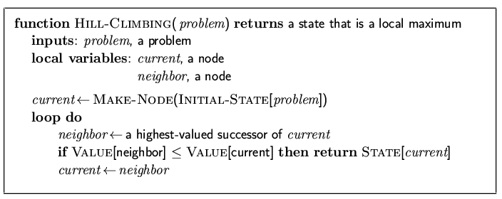
Hill-climbing search
"Like climbing Everest in thick fog with amnesia"

Slide 31
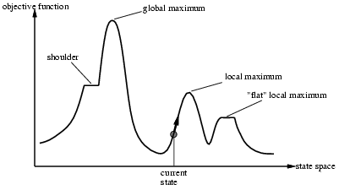
Hill-climbing search
Problem: depending on initial state, can get stuck in local maxima

Slide 32
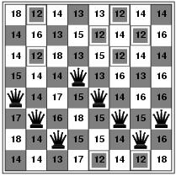
Hill-climbing search: 8-queens problem
h = number of pairs of queens that are attacking each other, either directly or indirectly
h = 17 for the above state

Slide 33
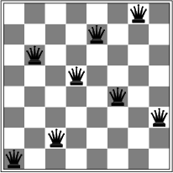
Hill-climbing search: 8-queens problem
A local minimum with h = 1

Slide 34
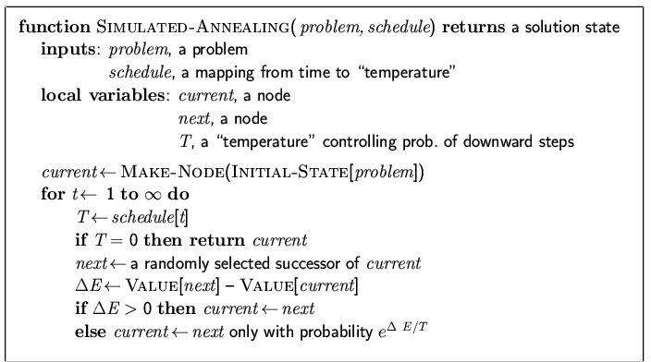
Simulated annealing search
Idea: escape local maxima by allowing some "bad" moves but gradually decrease their frequency

Slide 35
Properties of simulated annealing search
One can prove: If T decreases slowly enough, then simulated annealing search will find a global optimum with probability approaching 1
Widely used in VLSI layout, airline scheduling, etc

Slide 36
Local beam search
Keep track of k states rather than just one
Start with k randomly generated states
At each iteration, all the successors of all k states are generated
If any one is a goal state, stop; else select the k best successors from the complete list and repeat.

Slide 37
Genetic algorithms
A successor state is generated by combining two parent states
Start with k randomly generated states (population)
A state is represented as a string over a finite alphabet (often a string of 0s and 1s)
Evaluation function (fitness function). Higher values for better states.
Produce the next generation of states by selection, crossover, and mutation

Slide 38
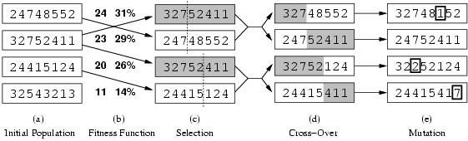
Genetic algorithms
Fitness function: number of non-attacking pairs of queens (min = 0, max = 8 × 7/2 = 28)
24/(24+23+20+11) = 31%
23/(24+23+20+11) = 29% etc

Slide 39
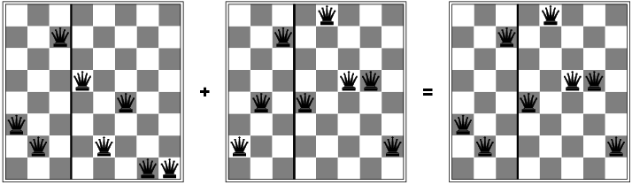
Genetic algorithms

